Slide 1
King County
House Price Prediction
September 16th, 2022
Karan & Han
Notes:
Hello, this is team Karan and Han,
This is our presentation for house price prediction for King County

Slide 2
Objective:
Help the real estate agency
to help homeowners buy/sell homes

Slide 3
Dataset
King County House Sales
21597 samples
House sales during 2014.5 to 2015.5

Slide 4
Chosen
Features
Mutual Needs
Recommending houses based on Budget
Investment Potentials
Notes:
Here are the chosen features for our model.
we chose some features based on 3 aspects.
That improve our model prediction.

Slide 5
Features
based on
Mutual Needs
Notes:
When you buy or sell a house,
There are some basic features to consider.

Slide 6
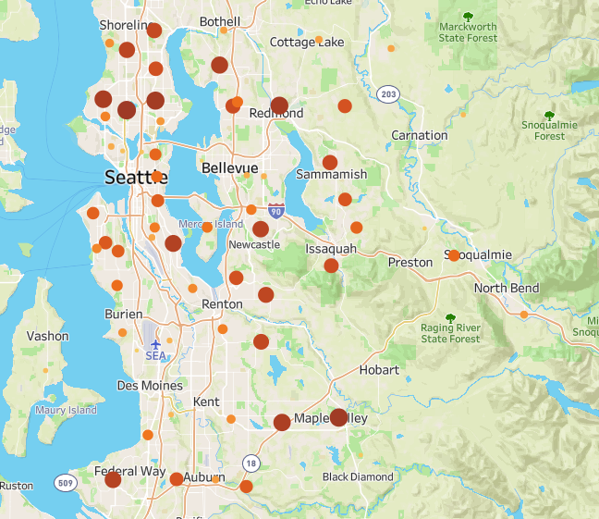
LOCATION! LOCATION! LOCATION!
Living space
Bedrooms, Bathrooms
View & Waterfront
House grade and condition
Notes:
Some areas in king county are more popular than the others
And living space, bedroom, bathrooms are among our chosen features.
And we consider the view and waterfront,
They not only spice up your house,
And they make your house more valuable.
Baseline model, accuracy 58%

Slide 7
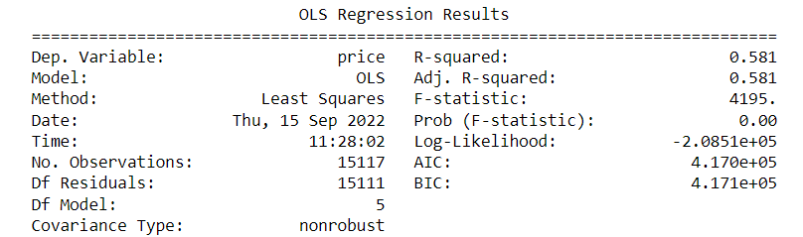

Slide 8
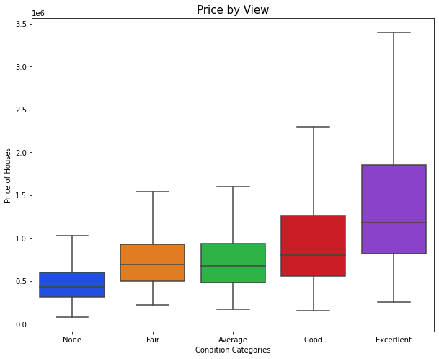
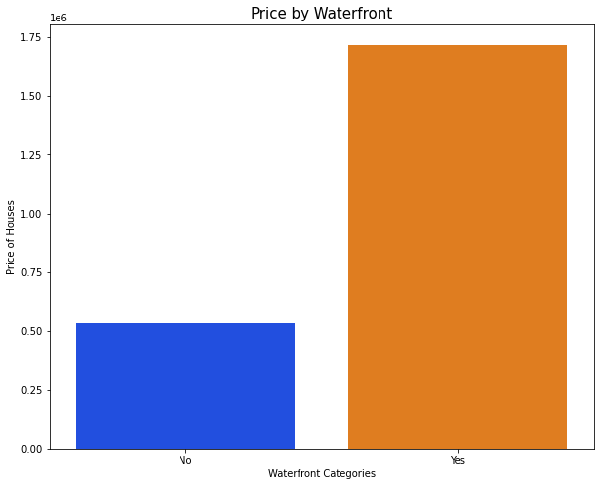
View & Waterfront
increase house value

Slide 9
Recommending houses based on Budget and optimizing features
Notes:
Cue Karan

Slide 10
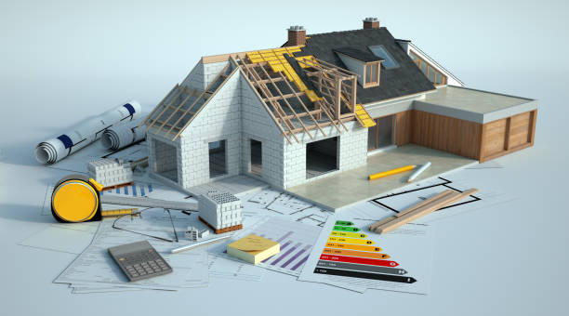
Grade,Basement Size and
Sqft living
Grading , Sqft living and basement size help in making better suggestions towards home buying
Grade how good is the construction and built of the house
Notes:
Grade determines how good is the construction and built of the house
So better the grade, better is the valuation on it.

Slide 11
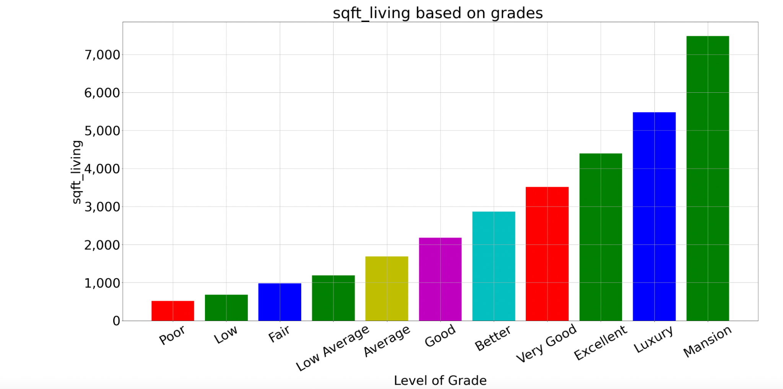
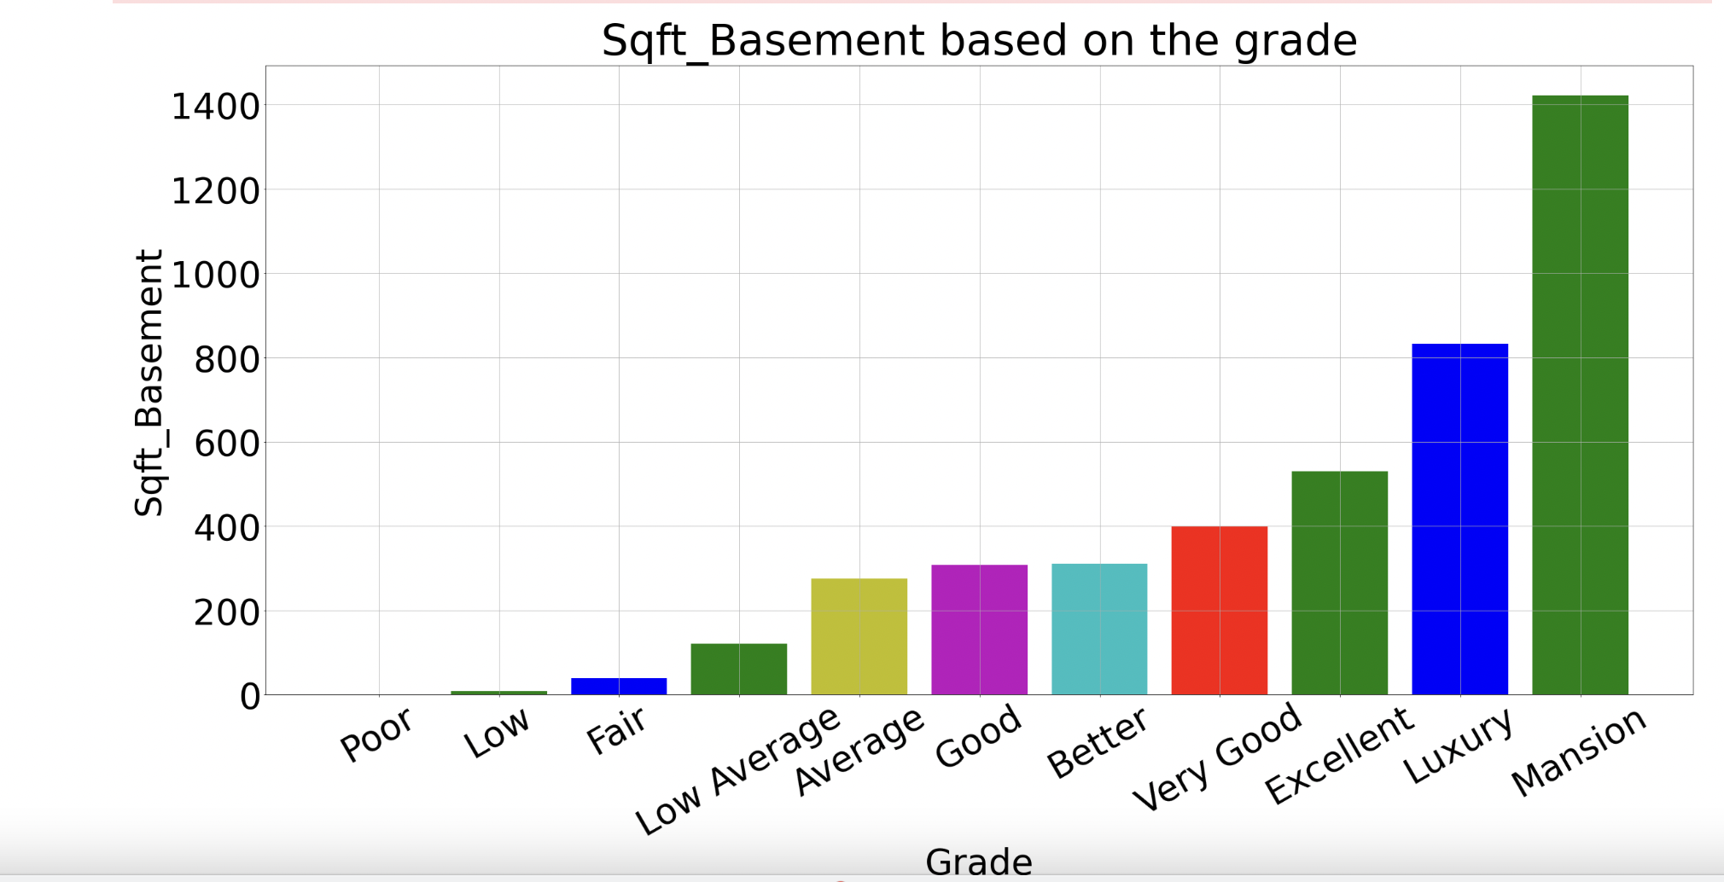
Grade based on Sqft living and Basement size
Notes:
sqft of living and sqft_basement are one of the key features in considering the grade.
So, if a customer wants to look for houses between 1000 and 2000 sqft, it can be seen that the Average, Good and Better grades work well
Based on these grades, the price of the houses to suggest, can be determined

Slide 12
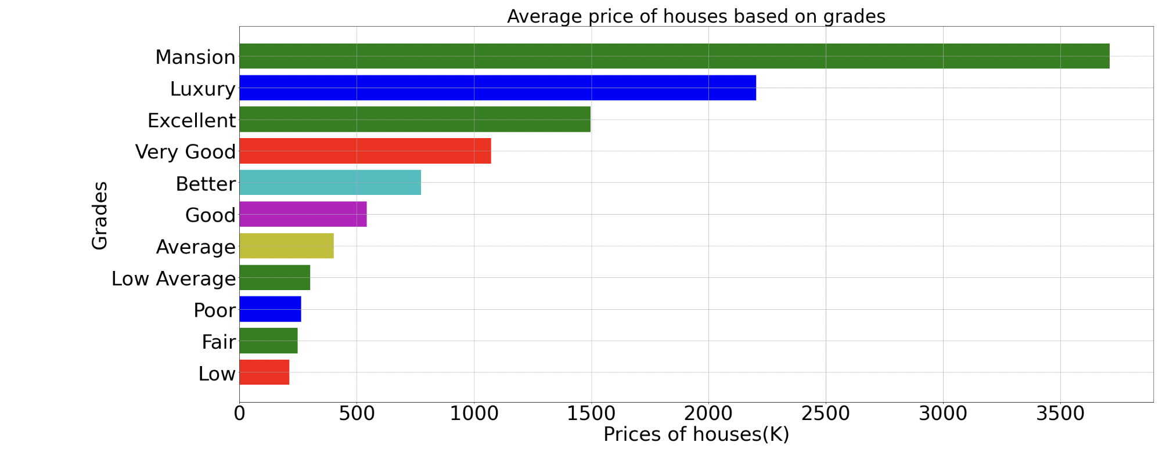
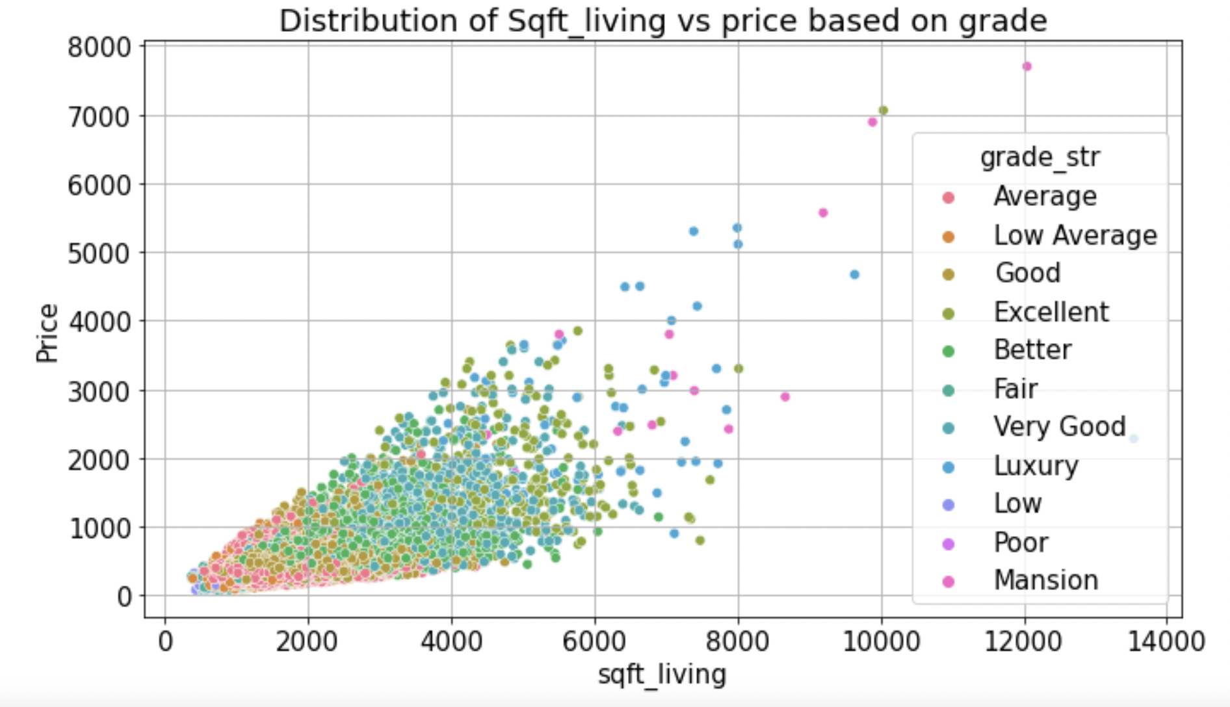
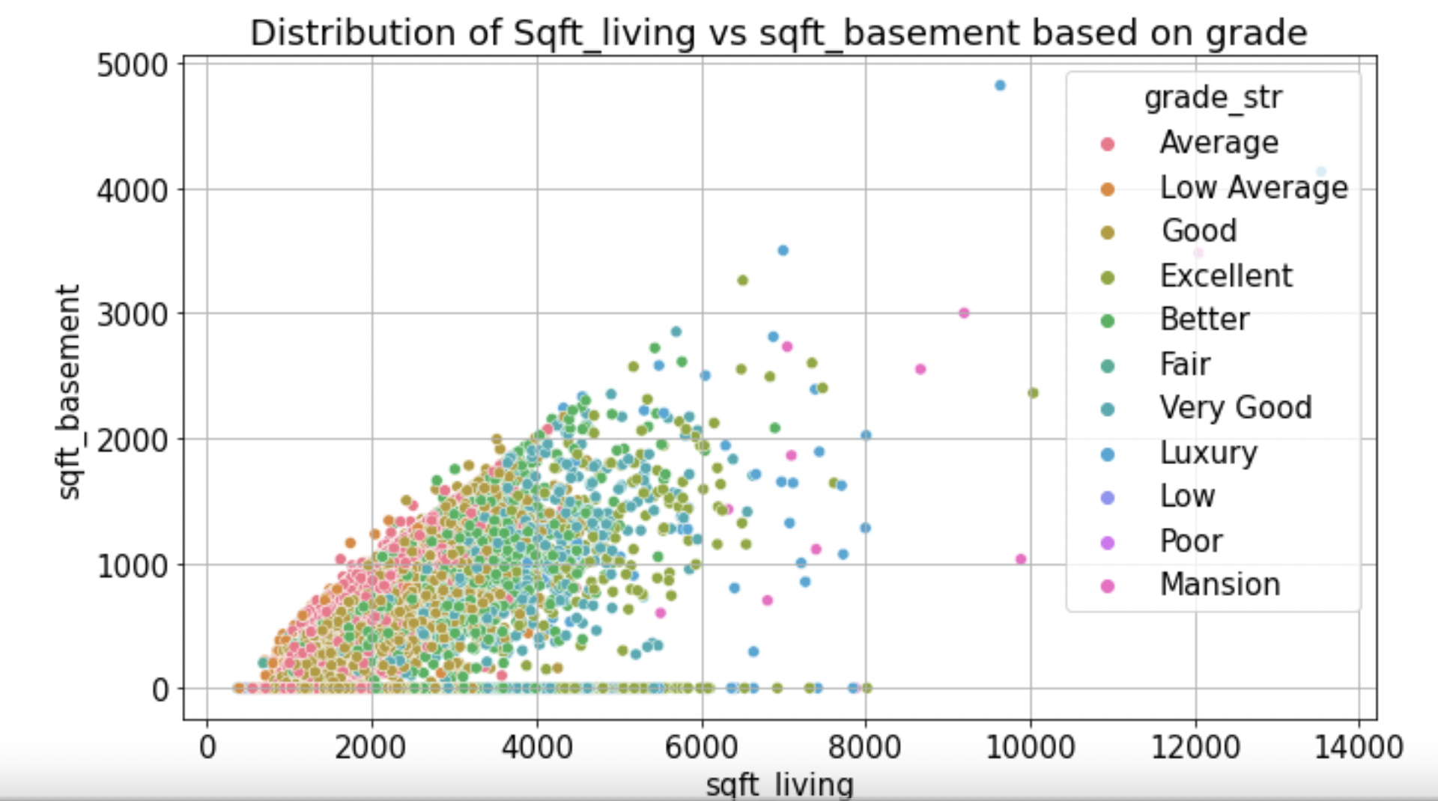
Determining price range based on the grades determined
Notes:
It can be see that for, average, Good and Better grades, the mean prices range from 400K and 750K.
Now we can explore the features that the customers might have in the house based on the budget
n

Slide 13
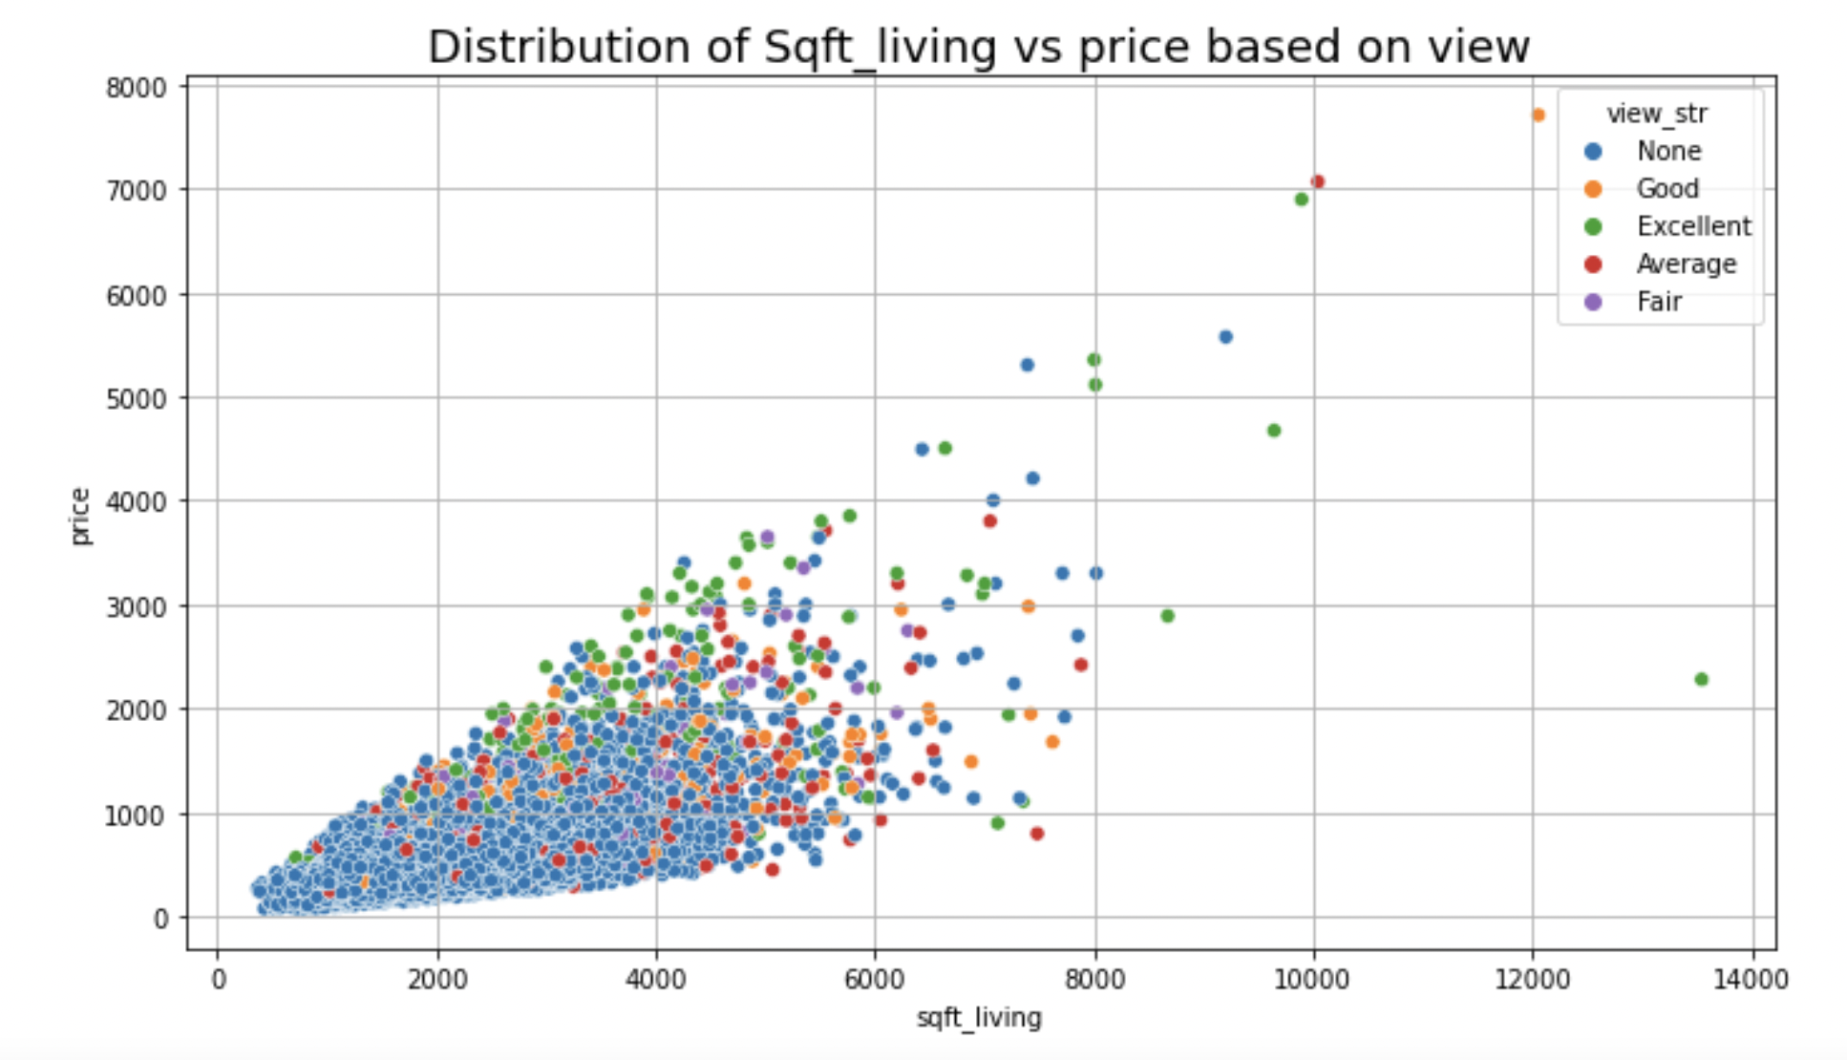
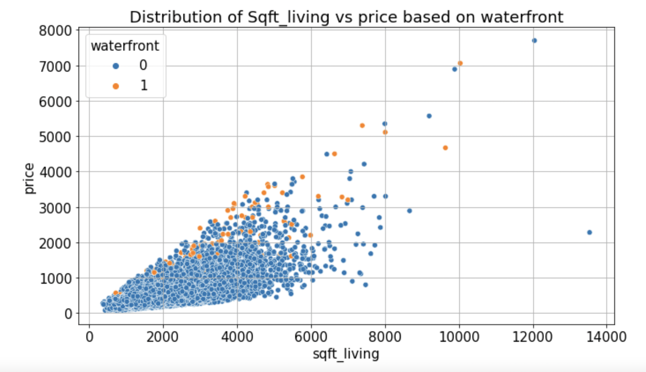
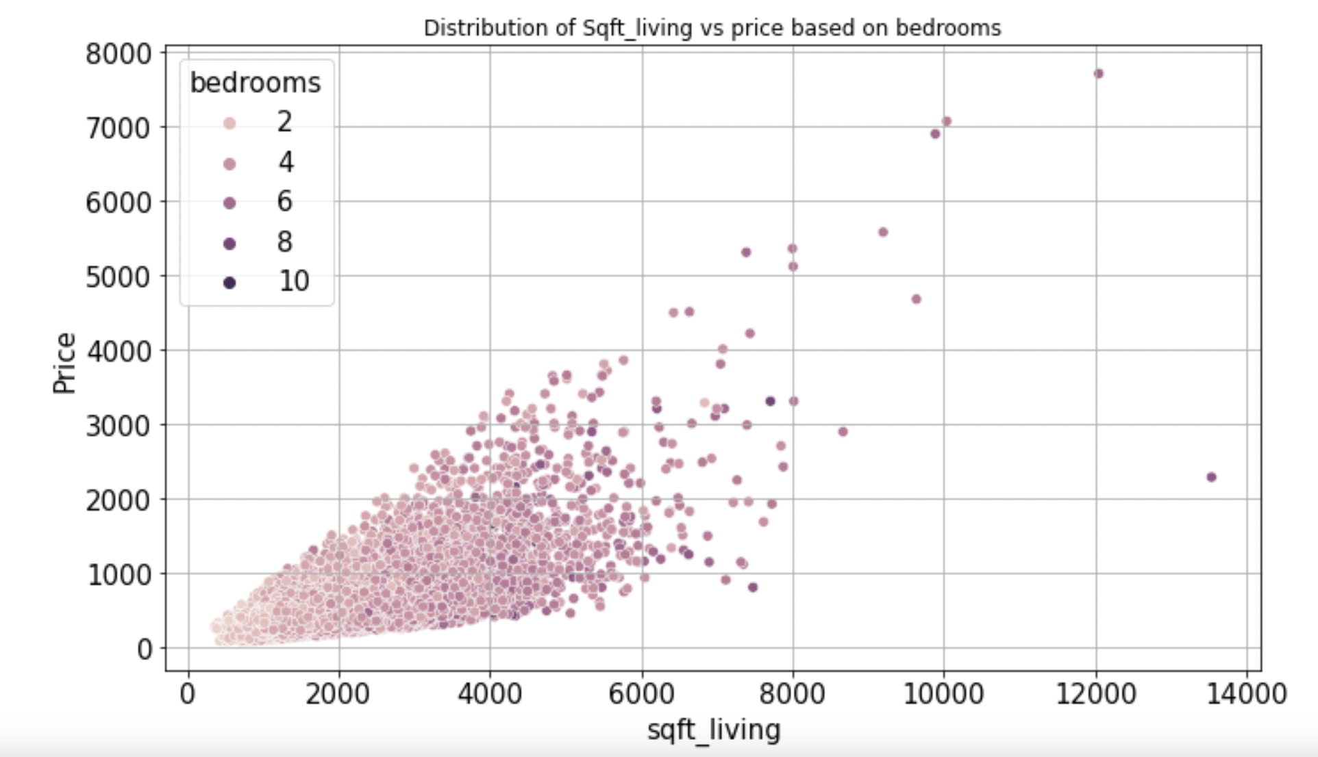
What features are eligible on the Budget determined
Notes:
Based on the budget, some features are not eligible
So, if the homebuyer wants to buy a home having a waterfront and view he might have to improve the price.

Slide 14
Improving Budget
Based on the budget, the houses can be suggested
Not all features are applicable for the budget
In order to include more features homeowners owners are recommended to improve features
Notes:
Here are the chosen features for our model.
we chose some features based on 3 aspects.
Help to improve our model prediction

Slide 15
Investment Potential
Historical Houses & Renovation
Notes:
Cue Han!

Slide 16
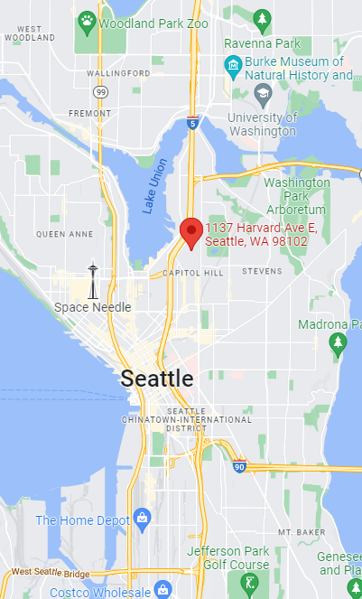
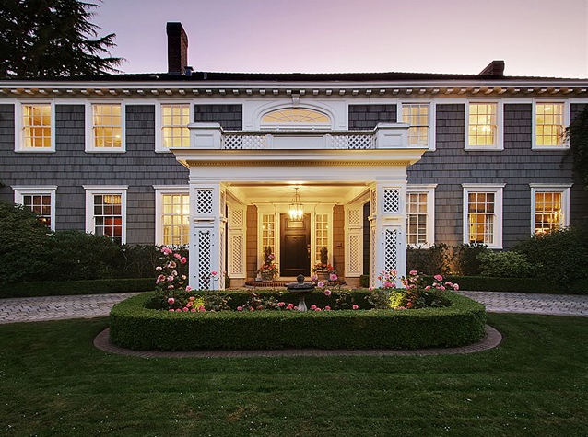
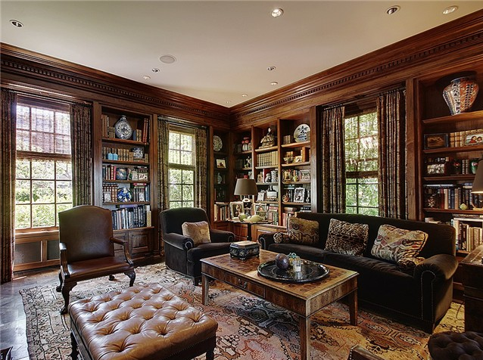
Most Expensive Capital Hill Home Sale
$ 7,700,000
1137 Harvard Ave E
built in 1910, renovated in 1987
Notes:
So this is how we got interested in the old houses.
This is the most expensive house in our dataset, 7M in 2014
And it’s really an eye catcher, it makes us so curious about older house performance.

Slide 17
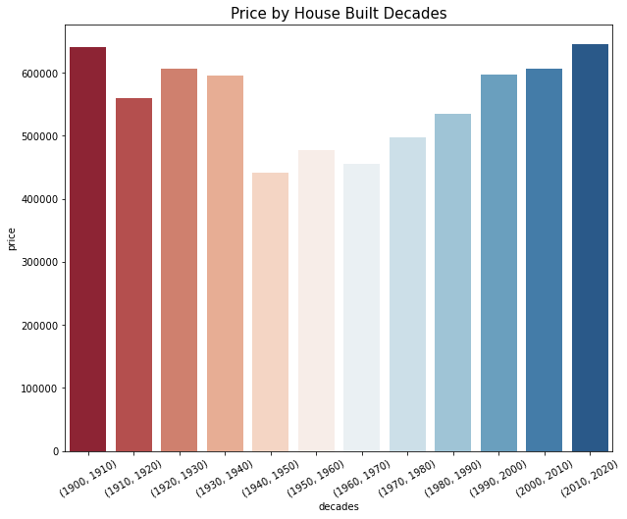
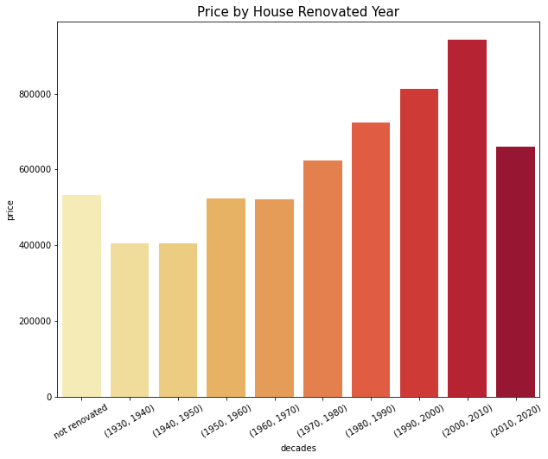
Price by House Built Year and Renovation
Notes:
Based on our dataset,
Old house sells as good as newer houses
Graph on the right shows:
The more lately renovated house sells better
So how about we combine the together?!

Slide 18
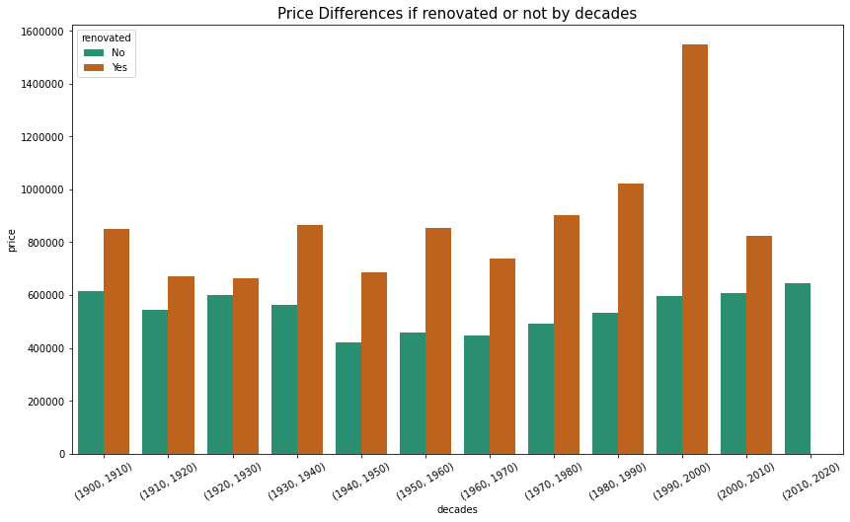
Renovation Adds Value
Notes:
This is a comparison of the price of house renovated or not.
Do renovation add a lot value

Slide 19
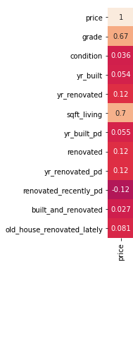
Old houses have more potential
20.3% of the houses built before 1940 has a view
24.7% of the houses built before 1940 locate near waterfront
Notes:
Old houses have more potential,
They built earlier, when it was still much easier to find a spot in king county. So their location is much better.
According to our data…
…
…

Slide 20
FINAL MODEL
Notes:
Based on the features we chose above, here is our final model

Slide 21
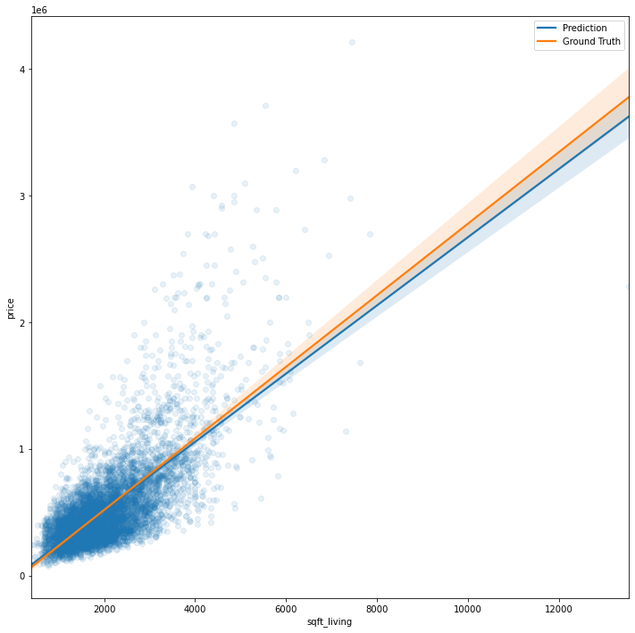
Prediction Result
R-squared
accuracy
0.817
Notes:
Explains 82% of the variation in the response variable around its mean

Slide 22
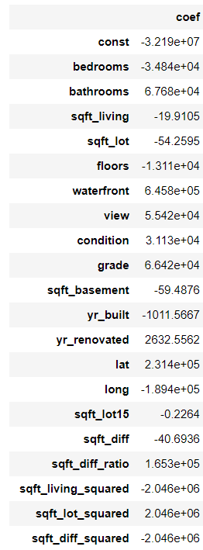
Regression Coefficients

Slide 23
Regression Coefficients
bedrooms -3.484e+04
bathrooms 6.768e+04
waterfront 6.458e+05
View 5.542e+04
condition 3.113e+04
grade 6.642e+04
yr_built_pd 6151.7760
yr_renovated 2632.5562

Slide 24
Recommendations:
Housing within reach, with improvements on the budget
Invest in old house and do renovations

Slide 25
Thanks!
And
Questions?

